Slide 1

OBJECT ORIENTED PROGRAMMING USING JAVA (CST 205)

Slide 2

MODULE 1
Introduction

Slide 3
Module 1 - Topics
Approaches to Software Design
Object Modeling Using Unified Language (UML)
Modeling
Introduction to Java

Slide 4
Module 1 - Topics
Approaches to Software Design
Object Modeling Using Unified Language (UML)
Modeling
Introduction to Java

Slide 5
Approaches to Software Design
√ Functional Oriented Design
√ Object Oriented Design
√ Case Study of Automated Fire Alarm System.

Slide 6
Software
Software
Software is a collection of instructions that enable the user to interact with a computer, its hardware or perform tasks.
Without software, most computers would be useless.
For example, without Internet browser software, we could not surf the Internet.
Without an operating system, the browser could not run on your computer.

Slide 7




Software - types
There are two types of software
System Software – E.g- Operating Compilers, Interpreters etc
System,
1. Application Software - Microsoft Word, MS paint, Microsoft PowerPoint etc.

Slide 8

Software Design
During the software design phase,
– the design document is produced, based on the customer requirements (documented in the SRS - Software Requirements Specification document)
The design process essentially transforms the SRS document into a design document.

Slide 9
Software Design
The design document produced at the end of the design phase should be implementable using a programming language in the subsequent (coding) phase.
Software design is the first step in SDLC (Software Design Life Cycle)

Slide 10
APPROACHES TO SOFTWARE DESIGN
There are two fundamentally different approaches to software design —
Function-oriented design,
Object-oriented design.

Slide 11
Functional Oriented Design (FOD)
In function-oriented design, the system is comprised of many smaller sub-systems known as functions.
These functions are capable of performing significant task in the system.

Slide 12
Functional Oriented Design (FOD)- Features
The salient features of the function-oriented design approach:
Top-down decomposition
Centralised system state

Slide 13
FOD-Top-down decomposition
A system at starting level(high level) is viewed as a black box that provides certain services (also known as high-level functions) to the users of the system.
This function may be refined into the sub-functions.
Each of these sub-functions may be split into more detailed subfunctions and so on.

Slide 14
FOD-Top-down decomposition
Function oriented design inherits some properties of structured design where divide and conquer methodology is used(top-down approach).

Slide 15
FOD (Top down design - example)
Consider a Library management System
Some of the functions in this system are:
create-new-library member
issue book
return book

Slide 16
FOD (Top down design -
example)
one function create-new-library-
Consider member member,
to creates the record for a new
This function may be refined into the following subfunctions:
assign-membership-number
create-member-record
print-bill
Each of these sub-functions may be split into more detailed subfunctions and so on.

Slide 17
FOD-Centralised system state
The system state is centralised and shared among different functions.
The system state can be defined as the values of certain data items that determine the response of the system to a user action or external event.
Such data in procedural programs usually have
global scope and are shared by many _{modules(function}P_{s}rep₎a.red by Renetha J.B. 17

Slide 18
FOD-Centralised system state(Eg.)
For example, the set of books (i.e. whether borrowed by different users or available for issue) determines the state of a library automation system.

Slide 19
FOD-Centralised system state(Eg)
For example, in the library management system,
several functions share data such
records for reference and updation:
create-new-member
delete-member
update-member-record
as member-

Slide 20
Function-oriented design approaches
Some
well-established function-oriented
design
approaches are :
Structured design by Constantine and Yourdon
Jackson’s structured design by Jackson
Warnier-Orr methodology
Step-wise refinement by Wirth
Hatley and Pirbhai’s Methodology

Slide 21
Object oriented Design
In the object oriented design approach, the system is viewed as collection of objects (i.e. entities).
The state is decentralized among the objects and each object manages its own state information.- no globally shared data

Slide 22
Object oriented Design(contd)
Each object is associated with a set of functions that are called its methods.
Each object contains its own data and is responsible for managing it.
The data internal to an object cannot be accessed directly by other objects
– can be accessed only through invocation of the methods of the object.

Slide 23
Object oriented Design(contd)
The object-oriented design paradigm makes extensive use of the principles of abstraction and decomposition.
Objects decompose a system into functionally independent modules.
Objects can also be considered as instances of abstract data types (ADTs).

Slide 24
Object oriented Design(contd.)
Data abstraction(data hiding):
The principle of data abstraction implies that how data is exactly stored is abstracted away.
This means that any entity outside the object will not have knowledge about
– how data is exactly stored, organised, and manipulated inside the object.
The entities external to the object can access the data internal to an object only by calling certain well- defined methods supported by the object.

Slide 25
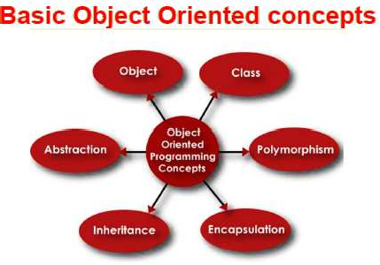

Slide 26
Object Oriented design
Function Oriented Design
The basic abstraction is the services(functions) that are available to the
The basic abstraction is real-world entities(objects) such as
users of the system such
member, book, book- register etc.
as issue
book ,display
book details etc.
state information is available in a centralised shared data store.
state information exists in
the form of
distributed
data among of the
oriented group
several system
Object techniques
objects
Function techniques functions constitute function)
oriented group
together a higher
(they level
functions together on the
basis of the data they
26
Prepared by Renetha _{o}J.B_{p}.
erate on.

Slide 27
Case Study of
Automated Fire Alarm System

Slide 28
Automated fire-alarm system— customer requirements
The owner of a large multi-storied building wants to have a computerised fire alarm system designed, developed, and installed in his building. Smoke detectors and fire alarms would be placed in each room of the building. The fire alarm system would monitor the status of these smoke detectors.

Slide 29
Automated fire-alarm system— customer requirements
The owner of a large multi-storied building wants to have a computerised fire alarm system designed, developed, and installed in his building. Smoke detectors and fire alarms would be placed in each room of the building.
The fire alarm system would monitor the status of these smoke detectors.

Slide 30
Automated fire-alarm system(contd.)
Whenever a fire condition is reported by any of the smoke detectors, the fire alarm system should determine the location at which the fire has been sensed and then sound the alarms only in the neighbouring locations.
The fire alarm system should also flash an alarm message on the computer console.

Slide 31
Automated fire-alarm system (contd.)
Fire fighting personnel would man the console round the clock.
After a fire condition has been successfully handled, the fire alarm system should support resetting the alarms by the fire fighting personnel.

Slide 32
Fire Alarm system-Function oriented design
/* Global data (system state) accessible functions */
BOOL detector_status [MAX_ROOMS];
int detector_locs [MAX_ROOMS];
by various
BOOL alarm_status [MAX_ROOMS]; /* alarm activated when status is set */
int alarm_locs [MAX_ROOMS]; /* room number where alarm is located
int neighbor alarm[MAX_ROOMS][10]; /* each detector has at most 10 neighboring locations */

Slide 33
Fire Alarm system-Function oriented design
The functions which operate on the system state are: interrogate_detectors()
get_detector_location() determine_neighbor() ring_alarm() reset_alarm() report_fire_location()

Slide 34
Fire Alarm system-Object oriented design
class detector
attributes: status, location, neighbors
operations:
create, sense_status, get_location, find_neighbors
class alarm
attributes: location, status
operations:
create, ring_alarm, get_location, reset_alarm
class sprinkler
attributes: location, status
operations: create, sprinkler

Slide 35
Analysis
Function oriented approach
Object oriented approach
The system state (data) is • The state information
centralised
functions
and access
several
and
(data) is distributed among various objects.
Data is private in different
modify this central data. Data is global and can be easily accessed.
The basic unit of designing
objects and cannot be
accessed by the other objects.
a function oriented • program is functions and modules.
Functions appear as verbs.
TOP DOWN
The basic unit of designing
an object oriented
program is objects.
Objects appear as nouns.
BOTTOM UP

Slide 36
Reference Text Book
Rajib Mall,
Fundamentals of Software
Engineering, 4th edition, PHI, 2014.

Slide 37
THANK YOU

Slide 38

OBJECT ORIENTED PROGRAMMING USING JAVA (CST 205)
Prepared by Prof.Renetha J.B. LMCST

Slide 39
MODULE 1
Introduction
Topic: Object Modeling Using Unified Modeling Language (UML)- Basic object oriented concepts
2

Slide 40
Model
A model is constructed by focusing only on a few aspects of the problem and ignoring the rest.
The model of a problem is called an analysis model.
The model of the solution (code) is called the design
model.
– The design model is usually obtained by carrying out iterative refinements to the analysis model using a design methodology.
3

Slide 41
Modelling language:
Modelling language: A modelling language consists of a set of notations using which design and analysis models are documented.
A model can be documented using a modelling language such as Unified Modelling Language (UML).
4

Slide 42
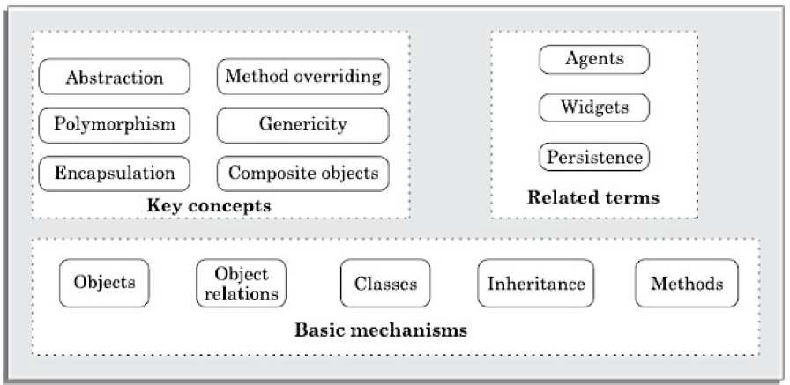
BASIC OBJECT-ORIENTED CONCEPTS
5

Slide 43
OBJECT-ORIENTATION CONCEPTS
Object
Class
Abstraction
Encapsulation
Class relationships
Inheritance
Association and link
Aggregation and composition
Dependency
Polymorphism
6

Slide 44
Object
Object in an
object-oriented program usually
represents
a tangible real-world entity (can be touched)
E.g.student, library member, a book, an issue register, etc.
or conceptual real-world entity
E,g. Loan, Job etc
Objects are real-world entities that has their own properties and behavior.
7

Slide 45
Object- Characteristics
Each object essentially consists of
some data that is private to the object and
a set of functions (termed as operations or
methods ) that operate on those data.
Each object hides its internal data from other objects.
An object can access the private data of another
object by invoking the methods supported by that object.
8

Slide 46
Object-Example
Consider Library Automation System.
Objects can be library member, book, staff etc.
Library Member object
private data
name of the member
membership number
address
methods
issue-book()
find-books-outstanding()
return-book()
9

Slide 47
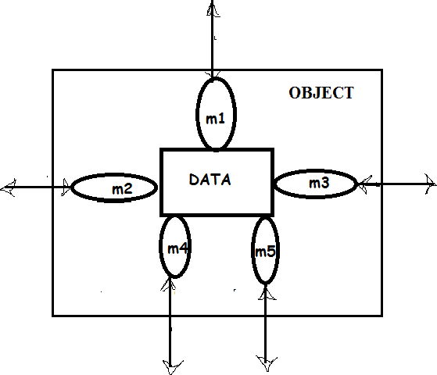
Object
Here m1 , m2 etc are methods associated with object
10

Slide 48
Class
Class is a group of similar objects.
A class is a blueprint or prototype from which objects are created.
A class is a generalized description of an object.
An object is an instance of a class.
11

Slide 49
Class(contd.)
All the objects in a class possess similar attributes
(properties) and methods (behaviour or operation).
E.g Set of all students(objects) form Student class
Each student object possesses
attributes(data)- Roll number, name etc.
behaviour(methods)- study(), read(), write() etc.
12

Slide 50
Example
E.g. Set of all library members(objects) would constitute the class LibraryMember
Each LibraryMember object has
– member
name membershi
number
member
address, etc.------> attributes(data)
– issue-book(), return-book(), etc.
----> behaviour(methods)
13

Slide 51
ADT
An Abstract Data Type is a type withassociated o, perations but its representation(inner details) is hidden.
ADT is based on three concepts
– Abstract data- data is hidden from outside. It can be only accessed through its methods.
– Data
structure-constructed from a
collection of
primitive data items.
– Data type- In programming language theory, a data type identifies a group of variables having a particular behavious, and can be used to instantiate a variable. E.g.int c;
14

Slide 52
Class-ADT
Class is an ADT
it has abstract data
it has structure
we can instantiate a class into objects.
15

Slide 53
Class and Object
Class is just a logical definition.
Consider Student class.
Let Sam is a student.
Sam is instance/object of the class Student
Object has a physical existence
16

Slide 54
Methods
Function inside the class is called method.
The operations (such as create(), issue(), return(), etc.) supported by an object are implemented in the form of methods inside the class.
Difference between operation and method
An operation is a specific responsibility of a class.
The responsibility is implemented using a method..
17

Slide 55
Method overloading
In some cases the responsibility of a class can be implemented through multiple methods with the same method name. This is called method overloading.
18

Slide 56
Method overloading-Example
E.g. Consider class named Circle
Assume that this class has three definitions for the create operation(method)—
int create()
draws a circle with radius given inside create() function
int create(int radius)
draws a circle with radius passed to create() function
int create(float x, float y, int radius);
draws a circle with radius at specific position in xy coordinate passed to create() function
19

Slide 57
Encapsulation
The wrapping up of data(variables) and function (methods) into a single unit (called class) is known as encapsulation.
20

Slide 58
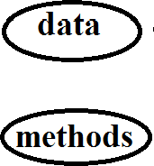
21

Slide 59
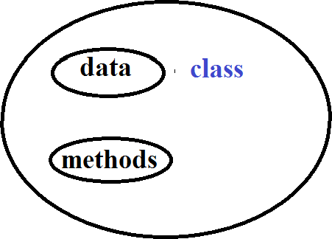
Encapsulation
22

Slide 60
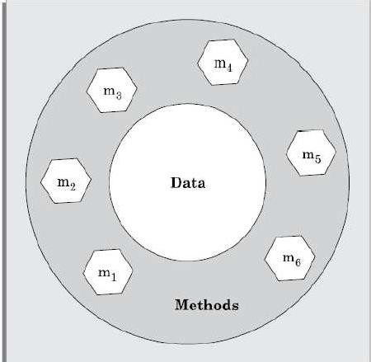
Encapsulation
23

Slide 61
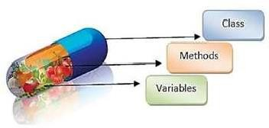
Encapsulation
24

Slide 62
Encapsulation - Advantage
Encapsulation offers the following three important advantages:
Protection from unauthorised data access:
Protect data from accidental corruption and concurrent access(simultaneous access) problems.
Data hiding-Helps to hide the internal structure data of an object.
provides abstraction, easier maintenance and bug correction.
Weak coupling- Since objects do not directly change each others internal data, they are weakly coupled. This enhances understandability of the design.
25

Slide 63
Abstraction
Abstraction mechanism
consider only those aspects of the problem that
are relevant to a given purpose
and to suppress all aspects of the problem that are not relevant.
Abstraction means displaying only essential information and hiding the inner details.
26

Slide 64
Abstraction(contd.)
Abstraction is supported in two different ways in an object-
oriented designs (OODs).
Feature abstraction- A class hierarchy can be viewed as defining several levels (hierarchy) of abstraction, where
each class is an abstraction of its subclasses.- Inheritance provides this.
Data abstraction - each object hides the exact way in which it stores its internal information from other objects .
27

Slide 65
Data abstraction-Real world example
Consider a man driving a car. The man only knows that pressing the accelerators will increase the speed of the car or applying brakes will stop the car
But he does not know about how on pressing accelerator the speed is actually increasing,
He does not know about the inner mechanism of the
car or the implementation of accelerator, brakes etc in the car.
This is what abstraction is.
28

Slide 66
Data abstraction -Advantage
An important advantage of the principle of data abstraction is that
It reduces coupling among various objects
Objects do not directly access any data belonging to each other.
It leads to a reduction of the overall complexity of
a design.
It helps in easy maintenance and code reuse.
29

Slide 67
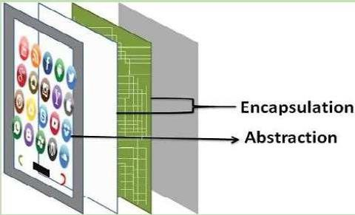
30

Slide 68
Class Relationships
Classes in a programming solution can be related to each other in the following four ways:
Inheritance
Association and link
Aggregation and composition
31

Slide 69
Inheritance
The capability of a class to derive properties and characteristics from another class is called Inheritance.
Inheritance is the process by which objects of one class acquired the properties of objects of another classes
32

Slide 70
Inheritance(contd.)
Derived Class: The class that inherits properties from another class is called Subclass or Derived Class or child class.
Super Class : The inherited by subclass
whose properties are is
class
Superclass or parentclass.
called Base Class
E.g. Doctor is a superclass. Surogreon and Neurologist are its subclasses
33

Slide 71
Inheritance
A base class is said to be a generalisation of its derived classes.
A base class is specialized into derived classes.
This means that the base class contains properties (i.e.,
data and methods) that are common to all its derived classes.
Derived class inherit the properties of base class. Derived can have their special own properties also.
34

Slide 72
Base class- Derived class
Each derived class can specialisation of its base class
be considered as a
– because it modifies
or extends
the basic properties of the base class in certain ways.
Therefore, the inheritance relationship can be viewed as a generalisation-specialisation relationship.
35

Slide 73
Inheritance - Example
Consider the classes Person, Employee, Student.
Employee is a person
Student is a person
Employee and Student inherit the properties of
Person class
36

Slide 74
Inheritance - Example
Consider the classes Person, Employee, Student.
Employee is a person
Student is a person
Employee and Student inherit the properties of
Person class
Super(base) class - Person
Derived(sub) class - Employee ,Student
37

Slide 75
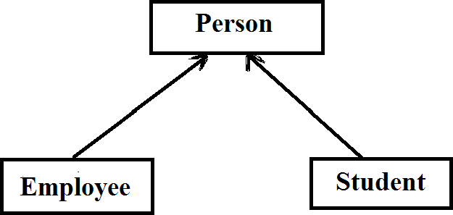
38

Slide 76
Inheritance example
Suppose Person class stores
data - name, aadhar number, address and data-of- birth
Methods-enter_details(), modify_details().
Employee is a subclass of class Person.
So Employee class inherits all data and methods of
Person class.
It can also contain data and methods specific to employee such as also empid, designation, calculate_experience()
39

Slide 77
Inheritance example
Suppose Person class stores
data - name, aadhar number, address and data-of-birth
Methods-enter_details(), modify_details().
Employee is a subclass of class Person.
contain data and methods specific to employee such as
also empid, designation, calculate_experience()
Employee-
data - name, aadhar number, address and data-of-birth
Methods-enter_details(), modify_details().
40

Slide 78
Inheritance - Example
Faculty, students, and library staff are library members.
Base class(superclass)- ?
Derived class(subclass) -?
41

Slide 79
Inheritance - Example
Faculty, students, and library staff are library members.
Base class(superclass)- Library member
Derived class(subclass) -Faculty ,students ,
library staff
42

Slide 80
Inheritance - Example
Faculty, students, and library staff are library members. Students fall in three categories PG, UG and research-scholars.
43

Slide 81
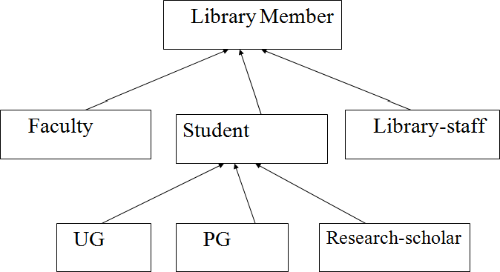
Class hierarchy
44

Slide 82
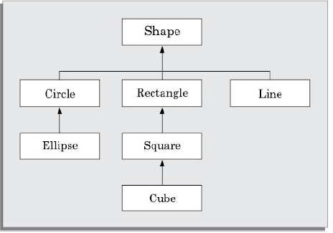
Class hierarchy of geometric objects
45

Slide 83
Method overriding
When a method in the base class is also defined in a derived class, then the method is said to be overridden in the derived class.
If subclass contain same method name superclass then subclass
as method overrides
superclass method
46

Slide 84
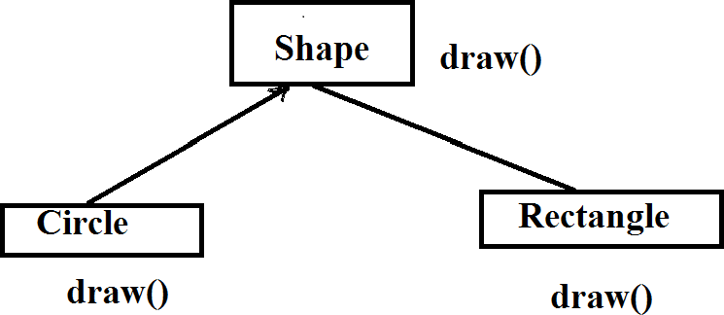
Method overriding
Method overriding
47

Slide 85
Polymorphism
Polymorphism literally morphism (forms).
means
poly
(many)
Real world example
– Diamond, graphite, and polymorphic forms of carbon
coal are called
48

Slide 86
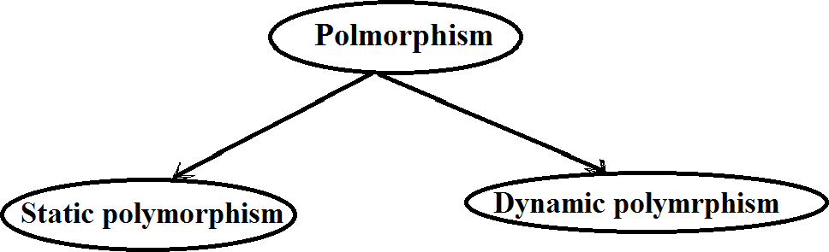
49

Slide 87
Static polymorphism
Static polymorphism occurs when multiple methods
implement the same operation.
Static polymorphism is also called static binding.
If a program has different methods with same name but different parameter types
– when that method is invoked(called), (there are different methods with same name here), the exact method which is to be bound to the method-call is determined at compile- time (statically).
50

Slide 88
Method overloading- static binding
Method overloading is a static polymorphism. Here a program (class) can have different functions with same name (but has different parameters).
51

Slide 89
Example-static polymorphism
Suppose class Circle has so many data and methods. Let Circle class has three methods named create
int create()
int create(int radius)
int create(int x, int y, int radius)
This is an example for method overloading.
52

Slide 90
Example-static polymorphism(contd.)
When create function is called without parameter then int create() method is invoked.
When create function is called with one integer parameter then int create(int radius) method is invoked.
When create function is called with three integer parameters then int create(int x, int y, int radius) method is
invoked.
53

Slide 91
Dynamic polymorphism
Dynamic polymorphism is also called dynamic binding.
In dynamic binding, when a method is called , the exact method to be invoked (bound) is known at the run time (dynamically) and cannot be determined at compile time.
54

Slide 92
Dynamic polymorphism(contd.)
Dynamic binding is based on two important concepts:
Assignment of an object to another compatible object.
Method overriding in a class hierarchy.
55

Slide 93
Dynamic polymorphism(contd.)
Assignment to compatible of objects
In object-orientation, objects of the derived classes are compatible with the objects of the base class.
That is, an object of the derived class can be assigned to an object of the base class, but not vice versa.
Method overriding
If subclass contain same method name as superclass then subclass method overrides superclass method
56

Slide 94
Dynamic binding summary
Even when the method of an object of the base class is invoked,
an appropriate overridden method of a derived class would be invoked
depending on the exact object that may have been assigned at the run-time to the object of the base class.
57

Slide 95
Advantage of dynamic binding
The principal advantage of dynamic binding is that
it leads to elegant programming and facilitates
code reuse and maintenance.
code is much more concise, understandable, and intellectually appealing
58

Slide 96
Relatioship between Objects
Association and Links
Aggregation
Composition
Dependancy
59

Slide 97
Association
Association is a common type of relation among classes.
The association relationship can either be bidirectional
or unidirectional.
An association describes a group of similar links.
– A link can be considered as an instance of an association relation.
An association between two classes simply means that zero or more links may be present among the objects of the associated classes at any time during execution.
60

Slide 98
Association
When two classes are associated, they can take each others help (i.e. invoke each others methods) to serve user requests.(binary association)
– if one class is associated with another bidirectionally, then the corresponding objects of the two classes know each others ids(identities).
61

Slide 99
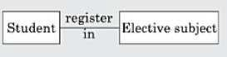
Association-Example
A Student can register in one Elective subject.
Here, the class Student is associated with the class ElectiveSubject.
Therefore, an ElectiveSubject object would
know the ids of all Student objects that have registered for the Subject
and can invoke their methods such as printName, printRoll a nd enterGrade.
This is example for binary association
62

Slide 100
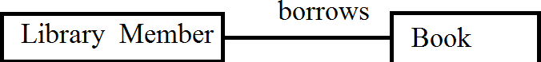
Association-Example
Consider another example of association between two classes: Library Member borrows Books.
Here, borrows is the association between the class LibraryMember and the class Book.
The association relation would imply that given a book, it would be possible to determine the borrower and vice versa.
63

Slide 101
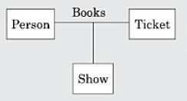
Association(contd.)
n-ary association
Three or more different classes can be involved in an association.
If three classes are associated then it is called 3-ary (ternary) association
E.g. A person books a ticket for a certain show.
Here, an association exists among the
Person, Ticket, and Show. This
classes is
tern
ary
association
.
64

Slide 102
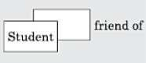
Association(contd.)
A class can have an association relationship with itself.
This is called
recursive association or unary association.
Example, consider the following—two students may be friends. Here, an association named friendship exists among pairs of objects of the Student class
65

Slide 103
Association(contd.)
Links are time varying (or dynamic) in nature.
Association relationship between two classes is static in nature.
If two classes are associated, then the association relationship exists at all points of time.
But links between objects are dynamic in nature.
Links between the objects of the associated classes can get formed and dissolved as the program executes.
66

Slide 104
Association(contd.)
Example, an association relationship named works-for
exists between the classes Person and Company.
Ram works for Infosys,
This implies that a link exists between the object Ram and the object Infosys.
Hari works for TCS
A works for link exists between the objects Hari and TCS.
If Ram may resign from Infosys and join Wipro. In this case, the link between Ram and Infosys breaks and a link between Ram and Wipro gets formed.
In all these case association works for remains there
67

Slide 105
Composition and aggregation
Composition and aggregation represent part/whole relationships among objects.
Composition/aggregation relationship is also known as
has a relationship.
Objects which contain other objects are called composite objects.
68

Slide 106
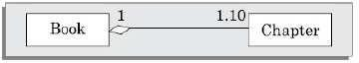
Composition and aggregation- Example
Example: A Book object can have upto ten Chapters.
Here a Book object is said to be composed of upto ten Chapter objects.
A Book has upto ten Chapter objects
69

Slide 107
Composition and aggregation(contd.)
Aggregation/composition can occur in a hierarchy of levels.
That is, an object may contain another object. This latter object may itself contain some other objects.
Composition and aggregation relationships cannot be reflexive.
That is, an object cannot contain an object of the same type as itself.
70

Slide 108
Association and aggregation(contd.)
Association
Association in terms of objects refers to "has a" relationship between two related objects. For example, a employee has a
communication address.
class Employee { String name;
Address communicationAddress;
}
class Address { String address;
}
71

Slide 109
Association and aggregation(contd.)
Aggregation
Aggregation in terms of objects refers to "has a"+ relationship between two related objects. For example, a department has multiple employees. It refers to having a
collection of child objects in parent class. For example:
class Department { String name;
List<Employee> employees;
}
class Employee { String name;
}
72

Slide 110
Composition and aggregation(contd.)
Composition
The composition is the strong type of association (“has a” or “has a+” relation. An association is said to composition if an Object owns another object and another object cannot exist
without the owner object.
73

Slide 111
Composition and aggregation(contd.)
class Department { String name;
List<Employee> employees;
Public void addEmployee(String ename) { Employee e = new Employee(ename); employees.add(e);
}
}
class Employee {
String name; Employee(String name) { this.name = name;}
}
74

Slide 112
Dependency
A class is said to be dependent on another class,
– if any changes to the latter class requires a change to be made to the dependent class.
E.g. class1 is dependent on class2 if any change is made in class2 then change is required in class1 too.
A dependency relation between two classes shows that any change made to the independent class would require the corresponding change to be made to the dependent class.
75

Slide 113
Dependency(contd.)
Two important reasons for dependency to exist between two classes are the following:
A method of a class takes an object of another class as
an argument.
E.g. class A
{
int function(class B){ ……………..}
}
A class implements an interface class.
If some properties of the interface class are changed, then a change becomes necessary to the class implementing the interface class as well.
76

Slide 114
Summary of class relationship
Aggregation
B is a part of A
A contains B
A is a collection of Bs
Composition
B is a permanent part of A
A is made up of Bs
A is a permanent collection of Bs
77

Slide 115
Summary of class relationship
Inheritance
A is a kind of B
A is a specialisation of B
A behaves like B
Association
A delegates to B
A needs help from B
A collaborates with B. Here collaborates with can be any
of a large variety of collaborations that are possible
credits,
among classes such as employs,
succeedpsr,etceeadcehse,s etc.
78

Slide 116
Abstract class
instances(objects)
Classes that are not intended to produce instances (Objects) are called abstract casses
are
an abstract class cannot be instantiated.
Objects cannot be created from abstract class.
– Abstract class act as base class in inheritance.
Abstract class usually support generic methods.
Advantage
code reuse can be enhanced
the effort required to develop software brought down.
79

Slide 117
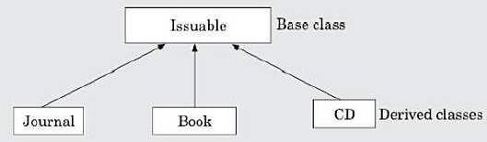
Abstract class- Example
Here Issuable is an abstract class and cannot be instantiated.
80

Slide 118
Advantages of OOD
Code and design reuse
Increased productivity
Ease of testing and maintenance
Better code and design undestandability enabling development of large programs
81

Slide 119
Disadvantages of OOD
The principles of abstraction, data hiding, inheritance, etc. do incur runtime overhead.
An important consequence of object-orientation is that the data that is centralized in a procedural implementation, gets scattered across various objects in an object-oriented implementation.
82

Slide 120
Object-oriented Programming Language(OOPL)
The first object-oriented language was Smalltalk.
Other OOPL are C++, Java etc.
programming
83

Slide 121
Reference Text Book
Rajib Mall, Fundamentals of Software Engineering, 4th edition, PHI, 2014.
84

Slide 122
Thank you
85

Slide 123

INTRODUCTION
- JAVA (Part 1)

Slide 124
Topics
Java programming Environment and Runtime Environment,
Development Platforms
Standard, Enterprise.
JVM
Java compiler,
Bytecode

Slide 125
Java
Developed by James Gosling from Sun Microsystems in
1991.
This language was initially called “Oak,” but was renamed “Java” in 1995.
The target of Java is to write a program once and then run this program on multiple operating systems. (WORA)
Java is a programming language
It has compiler, core libraries and a runtime (Java virtual machine(JVM)).

Slide 126
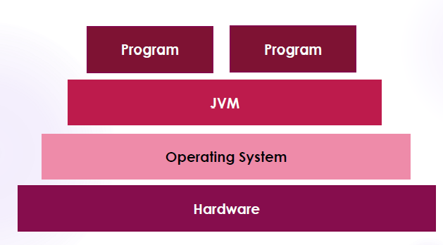

Slide 127
JVM
JVM is the Java run-time system.
Java Virtual Machine is called virtual because it provides a machine interface that does not depend on the operating system and machine hardware architecture.
So Java programs are WORA (Write Once Run Anywhere)p rograms.

Slide 128
JVM(contd.)
When we compile a Java program, we get .class file(bytecode) which is not executable.
JVM interprets the .class file into machine code depending on the operating system and hardware.
JVM executes java programs like a machine.
JVM is also responsible for garbage collection, array bond checking etc.
JVM is platform indepenedent.

Slide 129
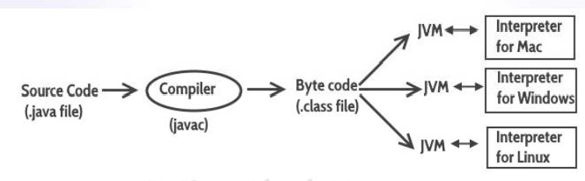

Slide 130
JRE
It is an installation package which provides environment to only run (not develop)the java program (or application) onto your machine.
JRE is only used by END-USERS of the system who only wants to run the Java programs
The JDK, along with the Java Virtual Machine (JVM) and the JRE, can be used by developers to program and run Java applications.

Slide 131
JDK
The Java Development Kit (JDK) is a software development environment used for developing Java applications.
It includes
The Java Runtime Environment (JRE)
An interpreter/loader (Java)
A compiler (javac)
An archive (jar)
A documentation generator (Javadoc)
Other tools needed in Java development.

Slide 132
JDK
JDK provides the environment to develop and execute(run)the Java program.
JDK is a kit(or package) which includes two things
Development Tools(to provide an develop your java programs)
JRE (to execute your java program).
environment to
JDK is used by Java Developers.

Slide 133
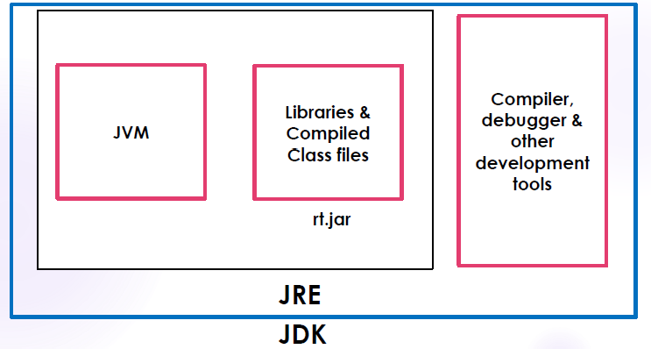
Jvm jre jdk

Slide 134
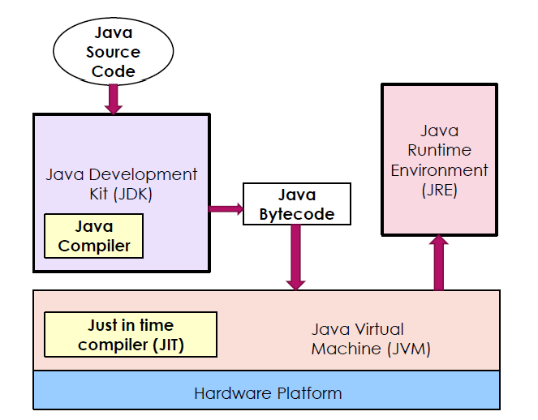
Interaction between JDK and JRE

Slide 135
Java Programming Environment
Java is a concurrent, class-based, object-oriented programming and runtime environment, consisting of
A programming language
An API specification
A virtual machine specification

Slide 136
Development Platforms
All Java platforms consist of a Java Virtual Machine (JVM) and an Application Programming interface (API).
The Java Virtual Machine is a program, for a particular hardware and software platform, that runs Java technology applications.
An API is a collection of software components that you can
use to create other software components or applications.

Slide 137
Development Platforms
Java development platform is a particular environment in which Java programming language applications run.
Java Platform, Standard Edition (Java SE)
Java Platform, Enterprise Edition (Java EE)
Java Platform, Micro Edition (Java ME)
Java FX

Slide 138
Development Platforms - Standard Edition
When most people think of the Java programming language, they think of the Java SE (Standard Edition) API.
Java SE's API provides the core functionality of the Java
programming language.
It defines everything from the basic types and objects of the Java programming language to high-level classes for networking, security, database access, graphical user interface (GUI) development, and XML parsing.
Java SE platform consists of a virtual machine, development tools, deployment technologies, and other class libraries and toolkits commonly used in Java technology applications.

Slide 139
Development Platforms –Enterprise Edition
The Java EE (Enterprise Edition) platform is built on top of the Java SE platform.
The Java EE platform provides an API and runtime environment for developing and running large-scale, multi-tiered, scalable, reliable, and secure network applications.

Slide 140
Development Platforms –Micro Edition
The Java ME platform provides an API and a small-
footprint virtual machine for running programming language applications on devices, like mobile phones.
Java small
This API is a subset of the Java SE API, along with special class libraries useful for small device application development.

Slide 141
Development Platforms –Java FX
Java FX technology is a platform for creating rich internet applications written in Java FX Script.
Java FX Script is a statically-typed declarative language that is compiled to Java technology bytecode, which can then be run on a Java VM.

Slide 142
Java Compiler
A Java compiler is a compiler for the Java programming language.
Java programs are compiled using javac command.
Command for compilation
javac Programname.java
The output of compiling the java code is not executable code. It is called bytecode (Programname.class)

Slide 143
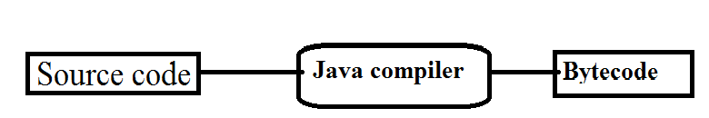
Program.java
Program.class

Slide 144
Java’s Magic: The Bytecode
The output of compiling the java code is not executable code. It is called bytecode.
Bytecode is a highly optimized set of instructions designed to be executed by the Java run-time system, which is called the Java Virtual Machine (JVM).
JVM was designed as an interpreter for bytecode.
Bytecode is a class file.

Slide 145
Bytecode(contd.)
Translating a Java program into bytecode makes it much easier to run a program in a wide variety of environments because only the JVM needs to be implemented for each platform. - PORTABILITY
Although the details of the JVM will differ from platform to platform, all JVM understand the same Java bytecode.
Bytecode has been highly optimized, so the use of bytecode enables the JVM to execute programs much faster.(eventhough compilation and interpretation is needed)

Slide 146
Bytecode(contd.)
When a JIT(Just In Time) compiler is part of the JVM, selected portions of bytecode are compiled into executable code in real time, on a piece-by-piece, demand basis.
JIT compiler compiles code as it is needed, during execution.
Not all sequences of bytecode are compiled—only codes that will benefit from compilation.
The remaining code is simply interpreted.
Java is a compiled interpreted language.

Slide 147
Bytecode(contd.)
Java bytecode is the intermediate representation of your Java program that contains instructions that Java Virtual Machine will execute.
Thus, the output of javac is not code that can be directly executed.

Slide 148
REFERENCE
Herbert Schildt, Java: The Complete Reference, 8/e, Tata McGraw Hill, 2011.

Slide 149
INTRODUCTION
- JAVA(Part 2)

Slide 150
Topics
Java applet
Java Buzzwords
Java program structure
Comments
Garbage Collection
Lexical Issues

Slide 151
Java applet
An applet is a special kind of small Java program
that is designed to be
transmitted over the Internet and
automatically executed by a Java-compatible web browser.
If the user clicks a link that contains an applet, the applet will be automatically downloaded and run in the browser.
The applets are used to provide interactive features to web applications.

Slide 152
Java applet(contd.)
Applets are typically used to
display data provided by the server,
handle user input, or
provide simple functions, such as a loan calculator, that execute locally, rather than on the server.
Applet allows some functionality to be moved from the server to the client.
Applet is a dynamic, self-executing program.

Slide 153
Applet - features
Usually a program that downloads and executes automatically on the client computer must be prevented from doing harm. It must also be able to run in a variety of different environments.
Java solved these problems in an effective and elegant way.
– Security- Java achieved security by confining an applet to the Java execution environment and not allowing it access to other parts of the computer.
– Portability- Same applet can be downloaded and
of CPUs, operating
executed by the wide variety
systems, and browsers connected to the Internet.

Slide 154
Applet(contd.)
Applets are
small applications
that are accessed on an Internet server,
transported over the Internet,
automatically installed,
and run as part of a web-document.

Slide 155
Applet(contd
Applets are not stand-alone programs.
– Instead, they run within either a web browser or an applet viewer.
JDK provides a standard applet viewer tool called
applet viewer.
In general, execution of an applet does not begin at main() method.

Slide 156
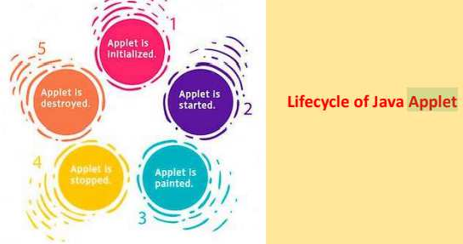

Slide 157
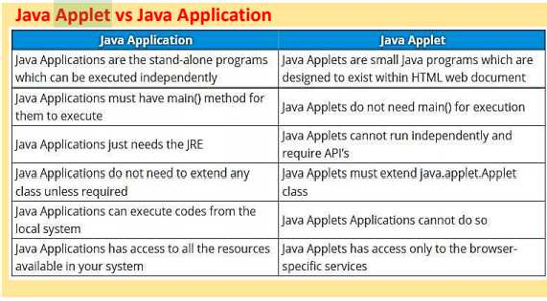

Slide 158
Java Buzzwords
Simple
Secure
Portable
Object-oriented
Robust
Multithreaded
Architecture-neutral
Interpreted
High performance
Distributed
Dynamic

Slide 159
Java Buzzwords(contd.)
Simple
– easy for the professional programmer to learn and use effectively.
Security
Java achieved security by confining to the Java execution environment and not allowing it access to other parts of the computer.
Portable
– Same Java program can be executed by the wide variety of CPUs, operating systems etc.

Slide 160
Java Buzzwords(contd.)
Object-Oriented
Atleast one class should be there.
everything is an object.
The object model in Java is simple and easy to extend, while primitive types, such as integers, are kept as high-performance nonobjects

Slide 161
Java Buzzwords(contd.)
Robust
the program must execute reliably in a variety of system.
Ability to create robust programs was given a high priority in the design of Java.
To gain reliability,
Java restricts us in a few key areas to force us to find mistakes early in program development.
Java frees us from having to worry about many of the most common causes of programming errors.
Because Java is a strictly typed language, it checks code at compile time. However, it also checks code at run time.

Slide 162
Why Java is Robust?(contd.)
•
Two main reasons for program failure are memory
management mistakes and mishandled exceptional conditions (that is, run-time errors).
– Memory management and Exception can be a difficult, tedious task in traditional programming environments.
Java virtually eliminates these problems by managing memory allocation and deallocation for us.
Java helps in handling exceptional conditions by
providing object-oriented exception handling.
So Java is robust.

Slide 163
Java Buzzwords(contd.)
Multithreaded
Java was designed to meet the real-world requirement of creating interactive, networked programs.
To accomplish this, Java supports multithreaded programming, which allows to write programs that do many things simultaneously.
Architecture-Neutral
A central issue for the Java designers was that of code longevity and portability.
Their goal was “write once; run anywhere, any time, forever.” WORA

Slide 164
Java Buzzwords(contd.)
Interpreted and High Performance
Java enables the creation of cross-platform programs by compiling into an intermediate representation called Java bytecode, which can be executed by JVM.
Java bytecode can be easily translated directly into native machine code for very high performance by using a just-in-time compiler.(JIT)
Java run-time systems that provide this feature.

Slide 165
Java Buzzwords(contd.)
Distributed
Java is designed for the distributed environment of the Internet because it handles TCP/IP protocols.
Java also supports Remote Method Invocation (RMI).
This feature enables a program to invoke methods across a network.

Slide 166
Java Buzzwords(contd.)
Dynamic
Java programs carry with them substantial amounts of run-time type information that is used to verify and resolve accesses to objects at run time.
This makes it possible to dynamically link code in a safe and expedient manner.
Small fragments of bytecode may be dynamically updated on a running system.

Slide 167
Java
Java is related to C++, which is a direct descendant of C.
From C, Java derives its syntax.
Many of Java’s object-oriented features were influenced by C++.

Slide 168
Java program
Write and save the source file(program code) as
Example.java in any directory.
E.g. D:\oop
Compile the program
javac Example.java
If there is error, then correct and save and compile program again.
The javac compiler creates a file called Example.class
that contains the bytecode version of the program.

Slide 169
Java program
If there is no error after compilation you can execute
the program using Java application launcher, called java
java Example
Here we are passing the class name Example as a command-line argument.
i.e. When we execute java command we are actually specifying the name of the class that you want to execute.
It will automatically search for a file by that name that has the .class extension. (Here Example.class)
If it finds the file, it will execute the code contained in the specified class.

Slide 170
Java program
In Java, a source file is officially called a compilation unit.
It is a file that contains one or more class definitions.
The Java compiler requires that a source file use the
.java filename extension.
In Java, all code must reside inside a class.
By convention, the name of that class in program should match the name of the file that holds the program.
Java programs are case sensitive.

Slide 171
Java program
If there is no public class then file name may be same or different from the class name in Java.
If there is a public class then the file name is same as the public class.

Slide 172
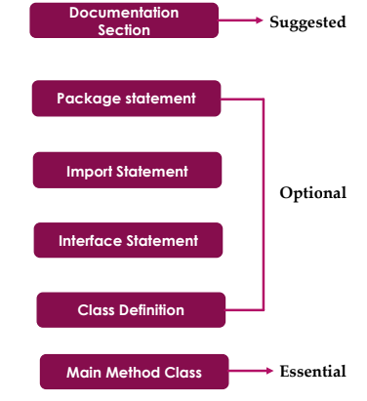
Java program structure

Slide 173
Documentation Section
We can write comments in this section.
Comments are beneficial for the programmer because they help them understand the code.
There are three types of comments that Java supports
Single line Comment
Multi-line Comment
Documentation Comment

Slide 174
Comments
Single line Comment
To comment a single line
Line start with //
Multi-line Comment
To comment many lines
Start with /* and end with */
Documentation Comment
Multi-line comment .
A doc comment appears immediately before a class, interface, method, or field definition and contains documentation for that class, interface, method, or field.
To document the API of the code.
Start with /* and end with */

Slide 175
Comments
Single line comment
//This is single line comment
Multi-line Comment
/* this is multiline comment. and support multiple lines*/
Documentation Comment
/**
*this is documentation
*comment
*/

Slide 176
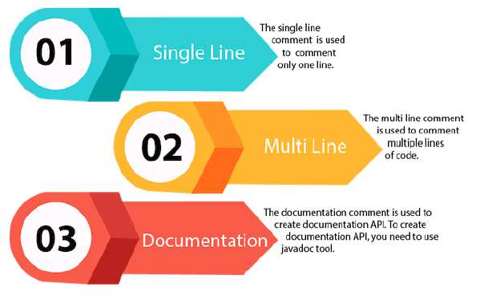
Comments
//
/*
*/
/** */

Slide 177
Package Statement
A package is a group of classes that are defined by a name.
– That is, if you want to declare many classes within one element, then you can declare it within a package
If you do not want to declare any package, then there will be no problem with it, and you will not get any errors.(Package is optional)
Package is declared as:
package package_name;
Eg: package mypackage;
We can create a package with any name.

Slide 178
Import Statement
If we want to use a class of another package, then we have to import it directly into your program using import statement.
Once imported, a class can be referred to directly, using only its name.
Syntax
import packagename;

Slide 179
Import Statement(contd.)
Many predefined classes are stored in packages in Java.
We can import a specific class or classes in an import statement.
Examples:
import java.io.*; // import all classes from java.io
package
import java.util.Date; //imports the Date class
import java.applet.*; /*imports all the classes from the
java.applet package*/

Slide 180
Interface Statement
This statement is used to specify interface in Java.
Interfaces are like a class that includes a group of method declarations.
It's an optional section and can be used when programmers want to implement multiple inheritances within a program.

Slide 181
Class Definition
A Java program may contain several class definitions.
Classes are the main and essential elements of any Java program.
A class is a collection of data and methods.
It is a good convention to start class name with capital letter
E.g
class Example{
}

Slide 182
Main Method Class
Every Java stand-alone program requires the main method as the starting point of the program.
– This is an essential part of a Java program.
There may be many classes in a Java program, and only one class defines the main method.
Methods contain data type declaration and executable statements.
class Classname
{
public static void main(String args[])
{
}
}
}
34

Slide 183
Main function
public static void main(String args[])
{
}
public means it can also be used by code outside of its class.
static is used when we want to access a method without creating its object.
void indicates that a function does not return a value.
main is the function name
String is a class.
– args is an array of instances of String

Slide 184
public static void main
When the main method is declared public, it means that it
can also be used by code outside of its class.
The word static is used when we want to access a method without creating its object (because we call the main method, before creating any class objects)
The word void indicates that a function does not return a value.
main( ) does not return a value.
main() is the starting point of a Java program.
Proper spaces can be given in program to make program
easier to read and understand -It is called indentation.

Slide 185
String args[ ]
String args[ ] is an array of instances of class String.
Each element is a string, which has been named as "args".
We can use any name instead of args.
If we Java program is run through the console, we can pass the input parameters (command line arguments), to main( ) method.
args receives any command-line arguments present when the program is executed.
String args[ ] can also be written as String[] args

Slide 186
System.out.println();
System.out.println();
This statement is used to print a text on the screen as output .
System is a predefined class.
out is an object of the PrintWriter class defined in the system
The method println() prints the text that is inside the ( ) on the screen and add a new line.
We can also use print() method instead method.(new line will not be added )
All Java statement ends with a semicolon.
of println()

Slide 187
Simple Java program
FIRST SIMPLE PROGRAM
/*
This is a simple Java program. Save this file "Example.java".
*/
import java.io.*; class Example
{
// Your program begins with a call to main().
public static void main(String args[])
{
System.out.println("This is a simple Java program.");
}
}

Slide 188
This program begins with the following lines:
/*
This is a simple Java program. Save this file "Example.java".
*/
This is a multiline comment.- more than one lines are commented. Lines inside /* and */ are comments
– NOT EXECUTABLE CODES
The contents of a comment are ignored by the compiler. Instead, a comment describes or explains the operation of the program to anyone who is reading its source code.

Slide 189
The next line of code in the program is :
import java.io.*;
This statement imports all classes in the java.io package. During compilation , the compiler will look at those classes.
java.io.* is Input/Output package

Slide 190
The next line of code in the program is :
class Example
{
class
class is being defined.
– Here Example is the identifier that is the name of the class.
The entire class definition, including all of its members, will be between the opening curly brace ({) and the closing curly brace (}).

Slide 191
single-line
The next line in the program is the
comment,
// Your program begins with a call to main().

Slide 192
Next line
public static void main(String args[])
This is the main function header
Main function definition
public static void main(String args[])
{
System.out.println("This is a simple Java program.");
}
System.out.println("This is a simple Java program.");
– prints the line This is a simple Java program. as output on the screen and control goes to new line

Slide 193
Simple Java program
FIRST SIMPLE PROGRAM
/*
This is a simple Java program. Save this file "Example.java".
*/
import java.io.*
class Example
{
// Your program begins with a call to main().
public static void main(String args[])
{
System.out.println("This is a simple Java program.");
}
}

Slide 194
D:/OOP> javac Example.java
D:/OOP> java Example
This is a simple Java program.

Slide 195
Garbage Collection in Java
Garbage collection is a process of releasing unused memory.
objects can be dynamically allocated using the new operator which can be automatically deallocated using garbage collector.
When no references to an object exist, that object is assumed to be no longer needed, and the memory occupied by the object can be reclaimed.
– The technique that accomplishes this is called garbage collection.

Slide 196
Garbage Collection in Java
When JVM starts up, it creates a heap area which is known as runtime data area. This is where all the objects (instances of class) are stored.
Since this heap area is limited, it is required to manage this area efficiently by removing the objects that are no longer in use.

Slide 197
Garbage collection(contd.)
The process of removing unused objects from heap memory is known as Garbage collection
– this is a part of memory management in Java.
Languages like C/C++ don’t support automatic garbage collection,
In Java, the garbage collection is automatic.

Slide 198
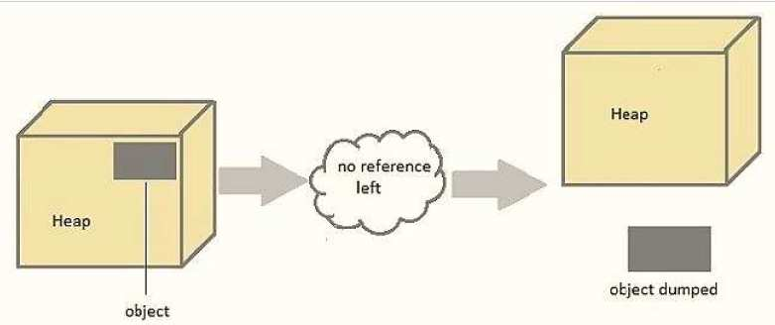

Slide 199
Garbage collection(contd.)
In java, garbage means unreferenced objects.
Main objective of Garbage Collector is to free heap memory by destroying unreachable objects.
Unreachable objects : An object is said to be unreachable if and only if(iff) it doesn’t contain any reference to it.
Eligibility for garbage collection : An object is said to be eligible for GC(garbage collection) iff it is unreachable.

Slide 200
Request for Garbage Collection
We can request to JVM for garbage collection however, it is upto the JVM when to start the garbage collector.
Java gc() method is used to call garbage collector explicitly.
However gc() method does not guarantee that JVM will perform the garbage collection.
It only request the JVM for garbage collection. This method is present in System and Runtime class.

Slide 201
finalize() method
finalize() method – This method is called each time just before the object is garbage collected and it perform cleanup processing.
By using finalization, we can define specific actions that will occur when an object is just about to be reclaimed by the garbage collector.
E.g if an object is holding some non-Java resource such as a file handle or character font, then we might want to make sure these resources are freed before an object is destroyed.

Slide 202
Garbage collection(contd.)
The Garbage collector of JVM collects only those objects that are created by new keyword.
So if we have created any object without new, we can use
finalize() method to perform cleanup processing

Slide 203
Lexical Issues
Java programs are a collection of JAVA TOKENS
Whitespace
Identifiers
Literals
Comments
Operators
Separators
Keywords.

Slide 204
Lexical Issues- Whitespace
Java is a free-form language.
We do not need to follow any special indentation rules.
It means that we can write statements(code) in java program all on one line or in any other strange way.
There should be at least one whitespace character between each token (if it is not already delineated by an operator or separator).
In Java, whitespace is a
Space
Tab
Newline.

Slide 205
Lexical Issues-Identifiers
Identifiers are used for class names, method variable names.
names, and
An identifier may be any descriptive sequence of
Uppercase letters ABCD……Z
Lowercase letters abcd…z
– Numbers 0123456789
Underscore _
Dollar-sign characters $
They must not begin with a number.
Java is case-sensitive

Slide 206
Lexical Issues-Identifiers
AvgTemp
count
2count
•
Valid
Valid
Invalid. should not begin with number
•
Not/ok
$test
this_is_ok
high-temp
Invalid. / not allowed
Valid
Valid
Invalid - not allowed

Slide 207
Lexical Issues- Comments
Single line
Multi-line
Documentation comment

Slide 208
Lexical Issues- Literals
A constant value in Java is created by using a literal representation of it.
Example of literals:
100 integer
98.6 'X'
floating point character
“This is a test” string
A literal can be used anywhere a value of its typeis allowed.

Slide 209
Operators
Operators are used for performing operations.
Arithmetic Operators
• +, -, *, /, %
• ++, +=, -=,*=, /=, %=, - -
Bitwise Operators ~ Bitwise unary NOT
&,| ,^
>> ,>>> ,<<
&=, |=, ^=, >>=, >>>=
Relational Operators
• = =, !=, >, < , <=, >=
Logical Operators
&, |, ^, ||,&&, &=,| =, ^=, ==, !=, ?:

Slide 210
Lexical Issues- Separators
In Java, there are a few characters that are used as separators.
Separator is a symbols that is used to separate a group of code from one another.
The most commonly used separator in Java is the
semicolon. ;

Slide 211
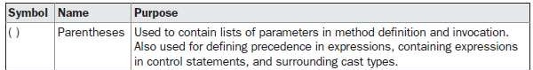
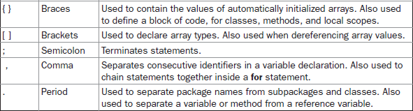
Lexical Issues- Separators(contd.)
The separators are

Slide 212
Lexical Issues- The Java Keywords
Keywords are reserved words.
There are 50 keywords currently defined in the Java language.
These keywords, combined with the syntax of the operators and separators, form the foundation of the Java language.
These keywords cannot be used as names for a variable, class, or method.

Slide 213
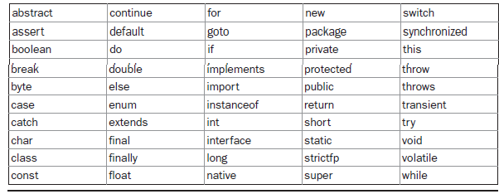
Lexical Issues- The Java Keywords
Java keywords

Slide 214
Special values
In addition to the following:
– true, false, null.
keywords, Java reserves the
These are values defined by Java.
We should not use these words for the names of variables, classes, and so on.

Slide 215
REFERENCE
Herbert Schildt, Java: The Complete Reference, 8/e, Tata McGraw Hill, 2011.

Slide 216

CS205 Object Oriented Programming in Java
Module 1 - Introduction (UML diagrams, Use case model)
Prepared by
Renetha J.B.
AP
Dept.of CSE,
Lourdes Matha College of Science and Technology

Slide 217

Topics
Core Java Fundamentals:
UML diagrams
Use case model

Slide 218
UML
UML (Unified Modeling
Language)
is a general-purpose,
Engineering.
Developed to help system and software developers for specifying, visualizing, constructing and documenting the artifacts of software systems
UML was created by the Object Management Group (OMG)
UML is not a programming language.
UML is a visual language for developing software blueprints (designs).
– For example, while constructing buildings, a designer or architect develops the building blueprints. Similarly, we can also develop blueprints for a software system.
graphical modeling language
in the field of Software

Slide 219
Advantages of using UML
Advantages of using UML
□ Readability and Reusability
□ Provides standard tool for software design
□ Helps reduce development cost
□ Makes communication and sharing programmers quite easy
□ Unification of all modelling concepts
ideas
among

Slide 220
UML DIAGRAMS
A UML diagram is a diagram based on the UML (Unified Modeling Language)
UML diagrams provide different perspectives of a software system to be developed.
Each perspective focuses on some specific aspect and ignores the rest.
UML diagrams helps to have a comprehensive understanding of the system.

Slide 221
UML diagrams
UML diagrams can capture the following views (models) of a system:
User’s view Structural view
Behaviourial view
Implementation view
Environmental view

Slide 222
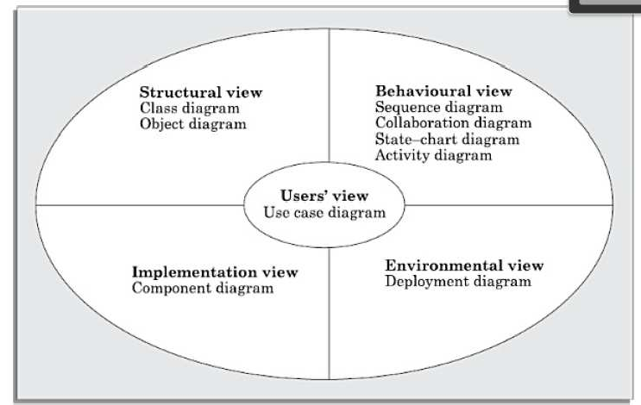
Different types of diagrams and views supported in UML.

Slide 223
Views of a system
The users’ view captures the view of the system in terms
of the functionalities offered by the system to its users.
The structural view defines the structure of the problem (or solution) in terms of the kinds of objects (classes). It also captures the relationships among the classes (objects).

Slide 224
Views of a system(contd.)
The behaviourial view captures how objects interact with each other in time to realize the system behaviour. It captures the time-dependent (dynamic) behaviour of the system.
This implementation view captures the important components of the system and their interdependencies.
Environmental view models how the different components are implemented on different pieces of hardware

Slide 225
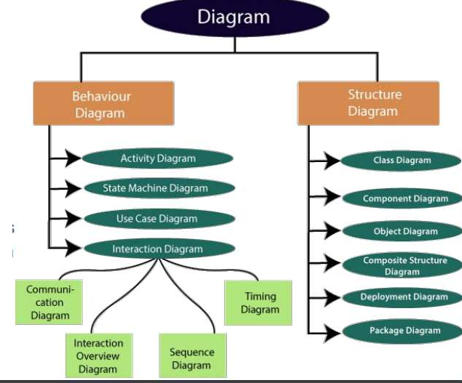
UML diagram

Slide 226
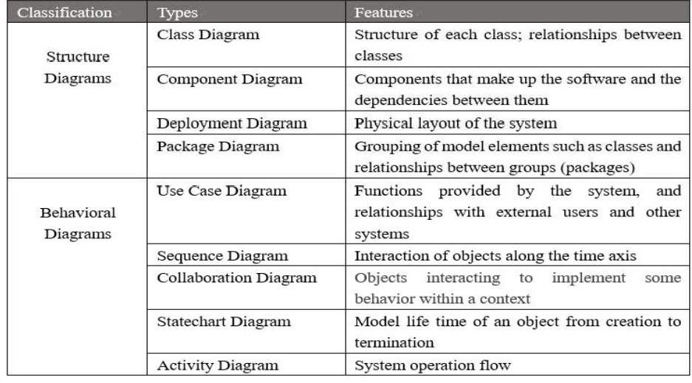

Slide 227
Use Case Diagram
Use case diagrams represents the functions provided by
the system and the relationships with external users or system.

Slide 228
Use Case Diagram
The use case model for any system consists of a set of use cases.
Use cases specify the expected behavior or functions (what it will do), and not the exact method of making it happen (how).
The purpose of a use case is to define a piece of coherent behaviour without revealing the internal structure of the system.
The use cases do not mention any specific algorithm to be used nor the internal data representation or internal structure of the software.

Slide 229
Use Case Diagram (contd.)
Use case specifies what are the actions that can be done by users in that system.
Library information system (LIS), the use cases could be:
issue-book
query-book
return-book
create-member
add-book, etc.

Slide 230
Use Case Diagram (contd.)
A use case consists of one main line sequence and
several alternate sequences.
The main line sequence represents the interactions between a user and the system that normally take place.
Several variations to the main line sequence (called alternate sequences) may also exist.
The main line sequence and each of the variations are called scenarios or instances of the use case.

Slide 231
Use Case Diagram (contd.)
E.g Withdraw cash form ATM
In the mainline sequence, use case supported by a ATM would be
the user inserts the ATM card, enters password, selects the amount withdraw option, enters the amount to be withdrawn, completes the transaction, and collects the amount.
The variations or alternate sequences can be:
Password is invalid.
The amount to be withdrawn exceeds the account balance.

Slide 232
Use Case Diagram (contd.)
Use case diagrams only summarizes some of the relationships between use cases, actors, and systems.
– It does not show the order in which steps are performed to achieve the goals of each use case.
Use cases correspond to the high-level functional requirements.

Slide 233
Use Case Diagram (contd.)
Use case model represents a functional or process model of a system.
Each use case is independent of the other use cases.
But implicit dependencies may exist among use cases because there may be dependencies among use cases at the implementation level due to factors such as shared resources, objects, or functions.
– For example, In the Bookshop Automation Software, update_inventory and sale_book are two independent use cases. But, during execution of sale_book there is an implicit dependency on update_inventory. If sufficient quantity of book is unavailable in the inventory, sale_book cannot operate until the inventory is replenished using update_inventory.(get more books and update the inventory)

Slide 234
Representation of Use Case diagram
Use Case
Use case in a system means operations in a system
In the use case diagram, each use case is represented by an ellipse with the name of the use case written inside the ellipse.
Use case

Slide 235

Representation of Use Case diagram(contd.)
Actors
Actor
The different users of the system are represented by
using stick person icons. They are called actors.
Both human users and external systems can be represented by stick person icons.
When a stick person icon represents an external system, it is annotated by the stereotype <<external system>>.

Slide 236
Representation of Use Cases(contd.)
An actor is a role played by a user with respect to the system use.
– E.g. Librarian can be actor in Library Management system
The same user may play the role of multiple actors.
An actor can participate in one or more use cases.

Slide 237
Representation of Use Case diagram(contd.)
Communication relationship
The line connecting an actor and the use case is called the communication relationship.
– It indicates that an actor makes use of the functionality provided by the use case

Slide 238
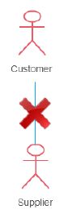
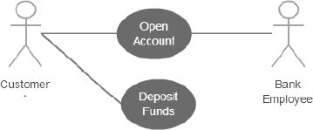
Association between actor and use case
An actor must be associated with at least one use case.
An actor can be associated with multiple use cases.
Multiple actors can be associated with a single use case.

Slide 239
Representation of Use Case diagram(contd.)
System Boundary
All the ellipses (i.e. use cases) of a system are enclosed within a rectangle which represents the system boundary.
The name of the system being modeled (e.g., library information system ) appears inside the rectangle.
Anything within the box represents functionality that is in scope and anything outside the box is not.
– However, drawing the system boundary is optional.

Slide 240
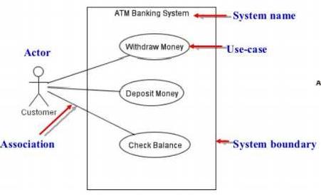
E.g. Use case diagram

Slide 241
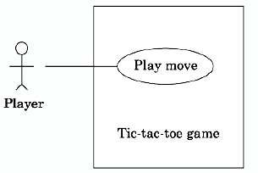
Example-Use case diagram
Tic-tac-toe game software
This software has only one use case, namely, “play move”

Slide 242
E.g. Super market prize scheme
A super market needs to develop a software that would help it to automate a scheme that it plans to introduce to encourage regular customers. In this scheme, a customer would have first register by supplying his/her residence address, telephone number, and the driving license number. At the end of each year, the supermarket intends to award surprise gifts to 10 customers who make the highest total purchase over the year.

Slide 243
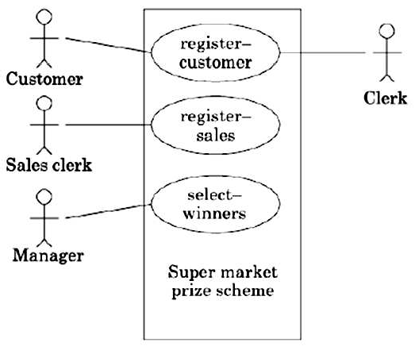
Example-Use case diagram
Super market prize scheme

Slide 244
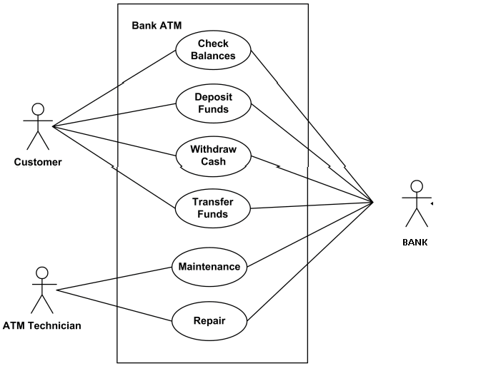
Example-Use case diagram

Slide 245
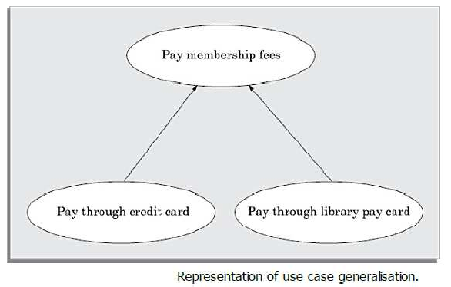
Generalisation
Generalisation works the same way with use cases as it does with classes.
The child use case inherits the behaviour and meaning of the parent use case.
Base and the derived use cases are separate use cases and should have separate text descriptions.

Slide 246
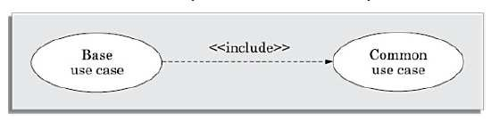
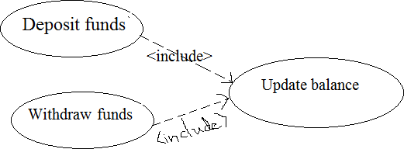
Includes
The includes relationship in the older versions of UML (was known as the uses relationship.
The includes relationship implies one use case includes the behaviour of another use case in its sequence of events and actions.
The includes relationship is represented using a predefined stereotype <<include>>.
Include use case is required not optional.

Slide 247
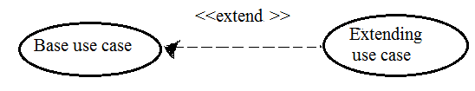
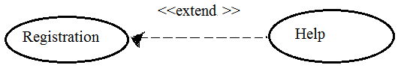
Extends
The main idea behind the extends relationship among use cases is that it allows to show optional system behaviour.
An optional system behaviour is executed only if certain conditions hold, otherwise the optional behaviour is not executed.
The extends relationship is normally used to capture alternate paths or scenarios.
– E.g. Help is the extending use
case of Registration.
Suppose if help option is clicked during Registration then only operation associated with Help is provided

Slide 248
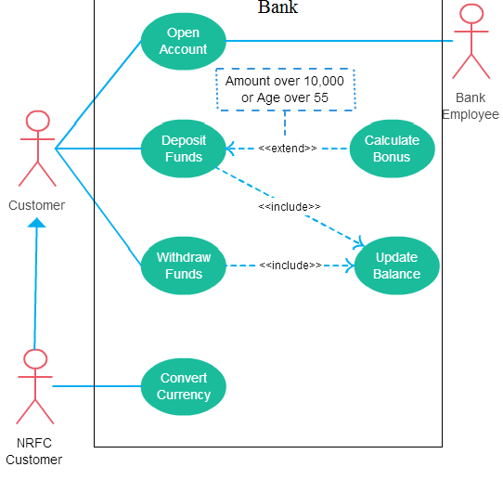
E.g.

Slide 249
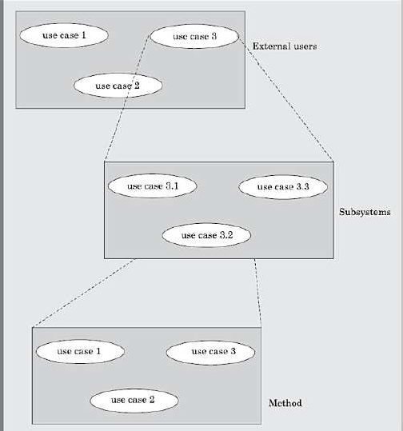
Organisation
When the use cases are factored, they are organised hierarchically. The highlevel use cases are refined into a set of smaller and more refined use cases
34

Slide 250
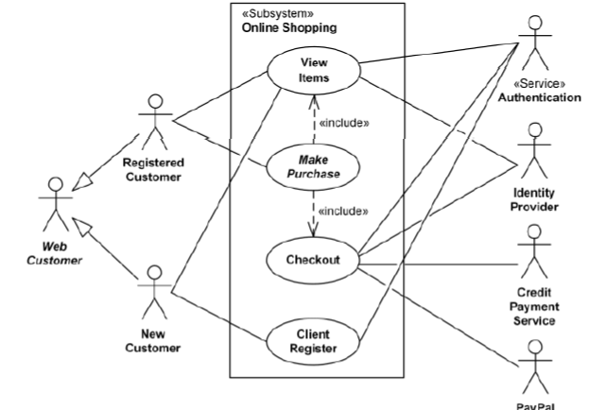
Online shopping-use case diagram

Slide 251
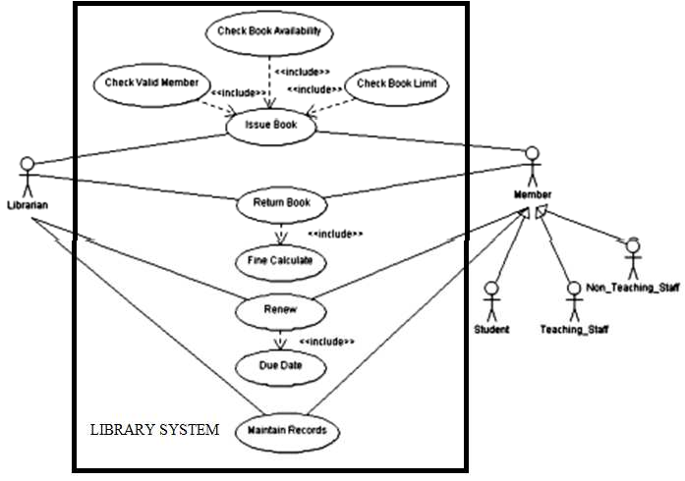

Slide 252


Use case

Slide 253

Geeralization vs Extend vs Include (Example)

Slide 254
Reference
Rajib Mall, Fundamentals of Software Engineering, 4th edition, PHI, 2014

Slide 255
CS205 Object Oriented Programming in Java
Module 1 - Introduction (Class diagram, Interaction diagram)
P rep ared by
Renetha J.B.
AP
Dept.of CSE,
Lourdes Matha College of Science and Technology
1

Slide 256
Topics
Introduction:
UML diagrams
Class diagram
Interaction diagram
2

Slide 257
Class diagram
A class diagram describes the static structure of a system.
The static structure of a system comprises a number of class diagrams and their dependencies.
The main constituents of a class diagram are
classes and
their relationships — generalisation, association, and various kinds of dependencies
aggregation,
3

Slide 258
Class diagram- CLASSES
The classes represent group of entities with similar features, i.e., attributes and Operations.
A class notation consists of three parts(compartments)
First compartment(mandatory) - Class Name
Second compartment(optional)- Attributes
Third compartment(optional)-Operations-
4

Slide 259
Class diagram- CLASSES
First compartment(mandatory) Class Name -The name of the class is written here.
Class name has following properties:-
is bold and centered.
use mixed case convention
starts with uppercase letter
Object names are written using a mixed case convention, but starts with a small case letter
5

Slide 260
Class diagram- ATTRIBUTES
Second compartment(optional)- Attributes (property of a class)
Attribute names are written left-justified using plain type letters, and the names should begin with a lower case letter
The attribute type can be shown after the colon.
The attribute name may be followed by an initialization expression. (initial value)
E.g. rollno:int=1
Initial value
attribute
type
6

Slide 261
Class diagram- ATTRIBUTES(contd.)
The multiplicity of an atttribute indicates the attributes per instance of the class.
number of
E.g. mark[3]:int
Here mark has mark[2].
three attributes mark[0],mark[1] ,
i.e. mark attribute can take 3 mark values
– An attribute without square brackets [] must hold exactly one value.
7

Slide 262

Class diagram- OPERATIONS
Third compartment(optional)-Operations-
The operation names are left justified, in plain type, and always begin with a lower case letter.
Abstract operations are written in italics.
The parameters of a function may have following kind
specified.
“in” - parameter is passed into the operation; (default)
“out”- parameter is only returned from the operation;
“inout” - parameter is used for passing data into the operation and getting result from the operation.
The return type of a method is shown after the colon at the end of the function signature.
The data type of parameters(arguments) are shown after the colon following the parameter name
E.g
8

Slide 263
Classname
attribute1 attribute2 ….. attributen
Operation1() Operation2() …… Operationn()
9

Slide 264




Class Diagram-examples
Class
No attribute No operations
Class with attribute (no
operations)
Class with attribute and operations
10

Slide 265

Class Diagram-examples
Class with operations but no no attributes
11

Slide 266

Class diagram-class visibility
To denote the visibility of the attribute and operation.
12

Slide 267
MyClass
+attribute1: type -attribute 2:type #attribute 2:type
+function1(in argument2 :type, out argument2:type):returntype -function(inout argument1:type,out argument2:type): returntype
13

Slide 268

Class Diagram
14

Slide 269



Represent the following entities using UML class diagram
a.) Book b.) Employee c.) Vehicle
15

Slide 270
Association
Association between two classes is represented by drawing a straight line between the concerned classes.
The name of the association is written along side the association line.
An arrowhead may be placed on the association line to
indicate the reading direction of the association.
16

Slide 271
Association(contd.)
On each side of the association relation, multiplicity can be noted
The multiplicity indicates how many instances of one class are associated with the other.
the multiplicity can be noted as an individual number or as a value range.
An asterisk * is used as a wild card and it means many (zero or more).
1 exactly one
* many
– Value
by
ranges of specifying
multiplicity are
noted
the minimum and maximum
va
 | lu₀e.,_{.1}se_{z}p_{e}a_{ro}ra_{o}t_{r}e₁d by two | 0^{d}..º*^{ts,} zero or many
 | 1..* 1 or many | 2..5 minimum 2. maximum 5
17

Slide 272

“Many books may be borrowed by a LibraryMember”.
18

Slide 273



OR ASSOCIATION
Car belongs to Person or Company
19

Slide 274
Aggregation
Aggregation is a special type of association relation .
Here classes are not only associated to each other, but a whole- part relationship exists between them.
The parts are NOT existence-dependent on the whole.
– E.g
of
a book
book
registeris an aggregation
objects. Books can be added to the register
whole
raenqdudirelde.tedBaosoaknd wchaenn exist eventhough there is no Bookregister.
Aggregation is represented by an empty(unfilled) diamond symbol at the aggregate end(whole) of a relationship.
The aggregation relationship cannot be reflexive (i.e. recursive).
– That is, an object cannot contain objects of the same class as itself.
part
20

Slide 275

Aggregation
Here document can be considered as an aggregation of paragraphs.
Each paragraph can in turn be considered as aggregation of lines.
Observe that the number 1 is annotated at the diamond end, and a * is annotated at the other end. This means that one document can have many paragraphs.
If we wanted to indicate that a document consists of exactly 10 paragraphs, then we have to write 10
21

Slide 276

Aggregation
A car is an aggregation of engine, seat ,wheel. They are parts of car.
If car is damaged then engine seat and wheel can be used for another.
22

Slide 277



Composition
Composition is a stricter form of aggregation, in which the parts are existence-dependent on the whole.
If whole is lost then parts does not exist.
Composition is represented as a filled diamond
drawn at the composite-end.
E.g. If man dies then his head, hand and leg also gets decayed.
whole
part
E.g. If order is cancelled no significance for the item ordered.

Slide 278
Aggregation versus Composition
Both aggregation and composition represent part/whole
relationships.
•
When the components can dynamically be added and
removed from agthgeregaagtgiorneg. ate, then the relationship is
If the components CANNOT be dynamically added/delete
then the components are have the same life time as the composite. It is composition.
Consider the example of an order consisting many order items.
If the order once placed, the items cannot be changed at all. In this case, the order is a composition of order items.
If order items can be changed (added, delete, and modified) after the order has been placed, then aggregation relation can be used to model it.
24

Slide 279

Inheritance
A generalization (inheritance) helps to connect a subclass to its superclass.
A sub-class inherit properties from its superclass.
Class diagram allows inheriting from multiple superclasses
A solid line with a hollow arrowhead that point from the child to the parent class.
25

Slide 280

Dependency
A dependency means the relation between two or more classes in which a change in one may force changes in the other.
– Dependency indicates that one class depends on another.
A dependency relationship is shown as a dotted line with open arrow that is drawn from the dependent class to the independent class.
26

Slide 281

Dependency-Example
27

Slide 282


Inheritance(examples)
Magazine is a publication.
Book is a publication
Printer is an output device..
Display monitor is an output device.
28

Slide 283

Inheritance(contd.)
The various
subclasses of a superclass can then be
differentiated by means of the discriminator. The set of subclasses of a class having the same discriminator is called a partition
29

Slide 284
Realization
Realization (Implements)
Realization relationship is a relationship between two model elements, in which one model element (the client) realizes (implements or executes) the behavior that the other model element (the supplier) specifies.
It is represented as a hollow triangle shape on the interface end of the dashed line.
30

Slide 285
Realization
Interface
Use keyword interface
Using the keyword interface, you can fully abstract a class’ interface from its implementation.
That is, using interface, you can specify what a class must do, but not how it does it.
Interfaces are syntactically similar to classes, but they
lack instance variables.
As a general rule, their methods are declared without any body.
Alternate way to implement Multiple Inheritace in Java
31

Slide 286

Realization(contd.)
E.g., the Owner interface might specify methods for acquiring property and disposing of property. The Person and Corporation classes need to implement these methods, in very different ways.
32

Slide 287
Realization
Implemening Interface
To implement an interface, a class must provide the complete set of methods required by the interface.
However, each class is free to determine the details of its own implementation.
By providing the interface keyword, Java allows you to fully utilize the “one interface, multiple methods” aspect of polymorphism.
Interfaces are designed to support dynamic method resolution at run time.
They disconnect the definition of a method or set of methods from the inheritance hierarchy
Normally, in order for a method to be called from one class to another, both classes need to be present at compile time so the Java compiler ca³n³ check to ensure that the method signatures are compatible.

Slide 288

Class Diagram – Library Management System

Slide 289

Object diagram
Object diagrams shows the snapshot of the objects in a system at a point in time.
Since it shows instances of classes, rather than the classes themselves, it is often called as an instance diagram.
The objects are drawn using rounded rectangles
35

Slide 290

Object diagrams
36

Slide 291
Interaction Diagrams
When a user invokes one of the functions supported by a system, the required behaviour is realised through the interaction of several objects in the system.
Interaction diagrams, are models that describe how groups of objects interact among themselves through message passing to realise some behaviour.
Each interaction diagram realises the behaviour of a single use case.
For complex use cases, more than one interaction diagrams may be necessary to capture the behaviour,
37

Slide 292
Interaction Diagrams(Contd.)
An interaction diagram shows a number of example objects and the messages that are passed between the objects within the use case.
There are two kinds of interaction diagrams—
sequence diagrams
collaboration diagrams.
 Any one of these diagrams can be derived automatically from the other.
 These two actually portray different perspectives of behaviour of a system and different types of inferences can be drawn from
38
them.

Slide 293
Interaction Diagram-Sequence diagram
A sequence diagram shows interaction among objects as a two dimensional chart. Sequence diagram shows only the behavioural aspects.
The chart is read from top to bottom.
The objects participating in the interaction are shown at the top of the chart as boxes attached to a vertical dashed line.
Inside the box, the name of the object is written with a colon separating it from the name of the class and both the name of the object and the class are underlined.
This signifies that we are referring any arbitrary instance of the class.
39

Slide 294
Interaction Diagram-Sequence diagram(Contd.)
An object appearing at the top of the sequence diagram signifies that the object existed even before the time the use case execution was initiated.
The object should be shown at the appropriate place on the diagram where it is created.
The vertical dashed line is called the object’s lifeline.
Absence of lifeline after some point indicates that the object
ceases to exist after that point in time, particular point of time.
If an object is destroyed, the lifeline of the object is crossed at that point and the lifeline for the object is not drawn beyond that point.
A rectangle called the activation symbol is drawn on the lifeline of an object to indicate the points of time at which the object is active.
40

Slide 295
Interaction Diagram-Sequence diagram(Contd.)
Each message is indicated as an arrow between the lifelines of two objects.
The messages are shown in chronological order from the top to the bottom.
That is, reading the diagram from the top to the bottom would show the sequence in which the messages occur.
Each message is labelled with the message name. Some
control information can also be included.
Two important types of control information are:
A condition (e.g., [invalid]) indicates that a message is sent, only if the condition is true.
An iteration marker shows that the message is sent many times to multiple receiver,
41

Slide 296

42

Slide 297

Messages
A message defines a particular communication between Lifelines.
1. Call Message
Call message is a kind of message that represents an
invocation of operation of target lifeline.
2. Return Message
Return message is a reply from the target lifeline for a
previous message.
Represented with dashed line with an open arrowhead
43

Slide 298




Messages(contd.)
3. Self Message
– Self message is a kind of message
that represents the invocation of message of the
same lifeline.
4. Recursive Message
– A self message sent for recursive purp
ose is
.
called a recursive messag
e
– It's target points to an activation on top of the
activation where the message was invoked from.
44

Slide 299
Messages(contd.)
5. Create Message / Constructor Message
Create message is a kind of message that represents the creation of (target) lifeline.
It creates the message receiver
6. Destroy Message / Destructor Message
Destroy message is a kind of message that represents the request of destroying the target lifeline.
It destroys the message receiver.
7. Duration Message / non-instantaneous message
Duration message shows the time delay between the send time and receive time of the message. (eg, network communication delay)
45

Slide 300



Messages(contd.)
8. Found message - Unknown sender
A Found message is used to represent a scenario where an unknown source sends the message.
9. Lost message - Unknown receiver
A Lost message is used to represent a scenario where the recipient is not known to the system.
46

Slide 301

Example for found message : unknown sender
47

Slide 302

Example for lost message: Unknown receiver
A message is lost
48

Slide 303

49

Slide 304

Duration Message

Slide 305

Sequence diagram for the issue book use case
47

Slide 306

Sequence diagram-E.g.
Emotion based music player
52

Slide 307
Interaction diagram-Sequence diagram(contd.)
Advantages
Sequence diagrams are easier to maintain and easier to
generate.
Represent the low level details of a UML use case.
Model the logic of a complex procedure, function, or
operation.
Shows the interaction between the objectsand components to complete a process.
53

Slide 308
Interaction diagram-Sequence diagram(contd.)
Disadvantages
Can be complex when too many lifelines are involved in the
system.
If the order of message sequence is changed, then incorrect
results are produced.
The type of message decides the type of sequence inside the diagram
Each sequence needs to be represented using different message numbering schemes, which can be a little complex in large systems
54

Slide 309
Interaction diagram-Collaboration diagram
A collaboration diagram shows both structural and behavioural aspects explicitly.
Each object is also called a collaborator.
The behavioural aspect is described by the set of messages exchanged among the different collaborators.
The structural aspect of a collaboration diagram consists of objects and links among them indicating association.
55

Slide 310
Interaction diagram-Collaboration diagram (contd.)
The link between objects is shown as a solid line and can be used to send messages between two objects.
The message is shown as a labelled arrow placed near the link.
Messages are prefixed with sequence numbers because they are the only way to describe the relative sequencing of the messages in this diagram.
Collaboration diagrams helps us to determine which classes are associated with which other classes.
56

Slide 311

Collaboration diagram(contd.)
57

Slide 312

Collaboration diagram E.g.
58

Slide 313

Collaboration diagram E.g.
59

Slide 314

Difference between sequence and collaboration diagrams
60

Slide 315

Interaction diagram-Collaboration diagram (contd.)
61

Slide 316

Sequence diagram – ordering system
62

Slide 317

Collaboration diagram-
eg Student login management
63

Slide 318
Reference
Rajib Mall, Fundamentals of Software Engineering, 4th edition, PHI, 2014
64

Slide 319
CS205 Object Oriented Programming in Java
Module 1 - Introduction (Activity diagram, State chart diagram)
Prepared by
Renetha J.B.
AP
Dept.of CSE,
Lourdes Matha College of Science and Technology
1

Slide 320
Topics
Introduction:
UML diagrams
Activity diagram
State chart diagram
2

Slide 321
Activity diagram
The activity diagram focuses on representing various activities
or chunks of processing and their sequence of activation.
– The activities in general may not correspond to the methods of classes. Activity diagram is flow of activities without trigger (event) mechanism.(not event driven)
An activity is a state with an internal action and one or more outgoing transitions. It is automatically followed by the termination of the internal activity.
If an activity has more than one outgoing transitions, then exact situation under which each is executed must be identified through appropriate
conditions.

Slide 322

Basic components of activity diagram
1. Nodes
Action: A single step in the activity wherein the users or software perform a given task.
Start node: Symbolizes the beginning
of the activity.
The start node is represented by
black circle.
End node: Represents the final step
in the activity.
The end node is represented by an
outlined black circle.
2. Control flows: also called connectors.
They show the control flow between steps in the diagram.
3. Partitions (optional) –
a
– to organize the nodes in the activity diagram.
4

Slide 323


Nodes- notations
Start symbol - Portrays the beginning of a set of actions or activities.
Action symbol - A task to be performed
Activity symbol - Indicates the set of actions that make up a modeled process. Includes short descriptions within the shape.
Object Node - A node that is used to define object flow in an activity
Flow final symbol - Represents the end of a specific process flow.
Does not represent the end of all flows in an activity.
No effect on parallel flows.
End symbol - Stop all control flows and object flows in an activity.
Represented by an outlined black circle
5

Slide 324



Control flow-notations
Action Flow or Control flow - referred to as paths and edges. They are used to show the transition from one activity state to another.
Joint symbol / Synchronization bar - Combines two concurrent activities and re-introduces them to a flow where only one activity occurs at a time. Represented with a thick vertical or horizontal line.
Fork symbol - Splits a single activity flow into two concurrent activities. Symbolized with multiple arrowed lines from a join.
Loop Node - A structured activity node that represents a loop with setup, test, and body sections
6

Slide 325

Fork join example
7

Slide 326





Notation
Decision Node - Represents a conditional branch point or decision node. A decision node has one input and two or more outputs.
– Guards are a statement written next to a decision diamond in [....]
Merge Node - Merges the control flows into a single one. The diamond symbol has several inputs and only one output.
Accepting an Event (Action) - This action waits for an event to occur. After the event is accepted, the flow that comes from this action is executed.
Sending Signals (Action) - Sending a signal means that a signal is being sent to an accepting activity.
8

Slide 327
Activity diagram(contd.)
Activity diagrams support description of parallel activities and synchronization aspects involved in different activities.
Parallel activities are represented on an activity diagram by using swim lanes.
Swim lanes enable you to group activities based on who is performing them, e.g., academic department vs. hostel office.
Thus swim lanes subdivide activities based on the responsibilities of some components.
9

Slide 328


Notation-Swimlanes
Swimlane and Partitions- A way to group activities(parallel activities) performed by the same actor on an activity diagram or to group activities in a single thread.
Swimlanes are used for grouping related activities in one column/row
Swimlanes can be vertical or horizontal, it adds modularity to the diagram

Slide 329

Example –student admission

Slide 330


Slide 331

An applicant wants to enroll in the university.
The applicant hands a filled out copy of Enrollment Form.
The registrar inspects the forms.
The registrar determines that the forms have been filled out properly.
The registrar informs student to attend in university overview presentation.
The registrar helps the student to enroll in seminars
The registrar asks the student to pay for the initial tuition.

Slide 332

Activity diagram - E.g.
Staff expense subimssion.

Slide 333

Activity diagram symbols

Slide 334
Statechart diagram
A state chart diagram is normally used to model how the state of an object changes in its life time.
If we are interested in modelling some behaviour that involves several objects collaborating with each other, state chart diagram is not appropriate. Use sequence or collaboration diagrams.
State chart diagrams are based on the finite state machine (FSM) formalism.
In FSM, the number of states becomes too many and the model too complex when used to model practical systems.
This problem is overcome in UML by using state charts.

Slide 335



Basic elements of a state chart
The basic elements of the state chart diagram are as follows:
Initial state: This represented as a filled circle.
Final state: This is represented by a filled circle inside a larger circle.
State: These are represented by rectangles with rounded corners.
Transition: A transition is shown as an arrow between two states.
Normally, the name of the event which causes the transition is places along side the arrow. We can also assign a guard(condition) to the transition [condition] event name

Slide 336
State chart diagram(contd.)
A state chart is a hierarchical model of a system and introduces the concept of a composite state (also called nested state ).
Actions are associated with transitions and are considered to be processes that occur quickly and are not interruptible. Activities are associated with states and can take longer.
An activity can be interrupted by an event.
Activity diagram is flow of activities without trigger (event) mechanism, state chart diagram consist of triggered states(driven by event)

Slide 337

State chart-(Example)-Order object

Slide 338

State chart-(Example)-Order object

Slide 339

State chart diagram-ATM

Slide 340
EXAMPLES

Slide 341

CLASSdiagram- Library

Slide 342

Library--Use case diagram

Slide 343

Book issue- Library—Sequence diagram

Slide 344

Library-Collaboration diagram

Slide 345


Library Issue book- Activity diagram
27

Slide 346

Library-State chart diagram

Slide 347

Railway System-Use case diagram

Slide 348
Reference
Rajib Mall, Fundamentals of Software Engineering, 4th edition, PHI, 2014
30

